Slide 1
Explainable Reasoning over Knowledge Graphs for Recommendation
Source : AAAI ’ 19
Speaker : Tzu-Yun, Chien
Advisor: Jia-Ling, Koh
Date: 2020/02/10

Slide 2
Outline
Introduction
Method
Experiment
Conclusion

Slide 3
Introduction

Slide 4
Recommended System

Slide 5
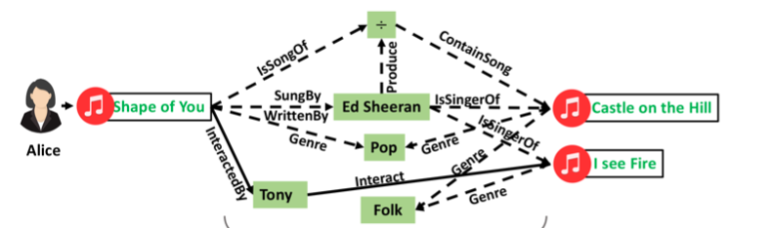
Knowledge Graph
(Alice, interact, Shape of You)
$⋀$ (Shape of You, SungBy, Ed Sheeran)
$⋀$ (Ed Sheeran, IsSingerOf, I see Fire)
$⇒$ (Alice, Interact, I see Fire)
$Κg$ = {(h, r, t)$| h, t ε ℰ, rε ℛ$}

Slide 6
Motivation
Existing efforts on knowledge graph have not fully explored the connectivity to infer user preferences.
They lack the reasoning ability to infer why a item is recommended for a user.

Slide 7
Goal
Propose a model named Knowledge-aware Path Recurrent Network (KPRN) to exploit knowledge graph for recommendation.
Generates representations for paths by accounting for both entities and relations and performs reasoning based on paths to infer user preference.

Slide 8
Method

Slide 9
Model Architecture
${\hat{y}}_{ui}=f_{Θ}$(u, i | $𝒫$(u, i))
(Alice, Interact, I see Fire) ?

Slide 10
Embedding Layer
Given path $p_{k}, project$ into embedding vector.
- $e_{l}∈R^{d} ,e_{l}^{′} ∈R^{d}$, $r_{l}∈R^{d}$ , d is the embedding size.
$p1=[ Alice\underset{→}{interact}Shape of You\underset{→}{SungBy}Ed Sheeran\underset{→}{Produce}÷ \underset{→}{ContainSong}I see Fire;]$

Slide 11
LSTM Layer
Concatenate the embedding as the input vector
$x_{l−1 }=e_{l−1 }⨁{ e}_{l−1}^{′}⨁$ $r_{l−1 }$

Slide 12
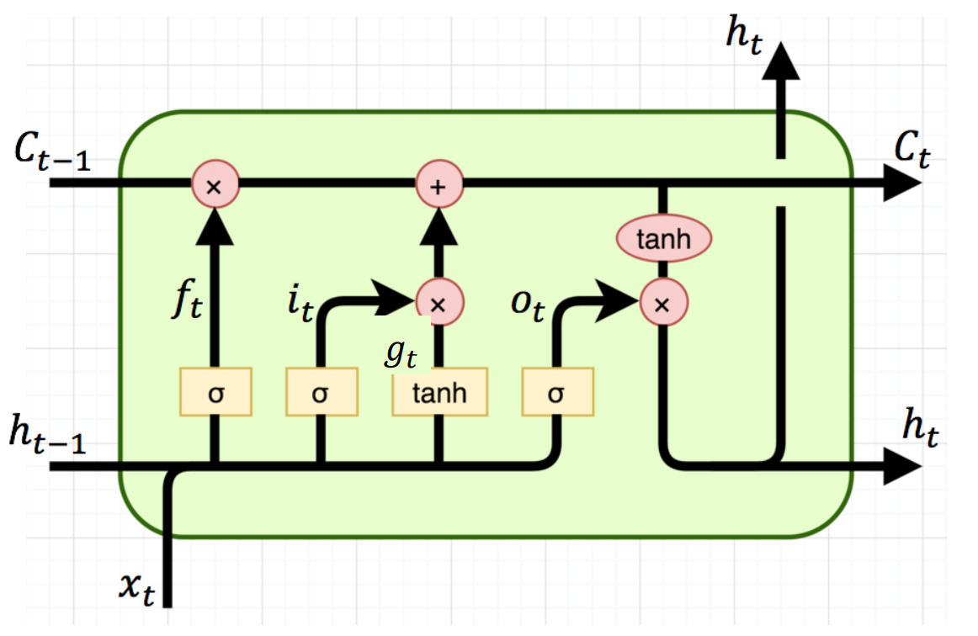
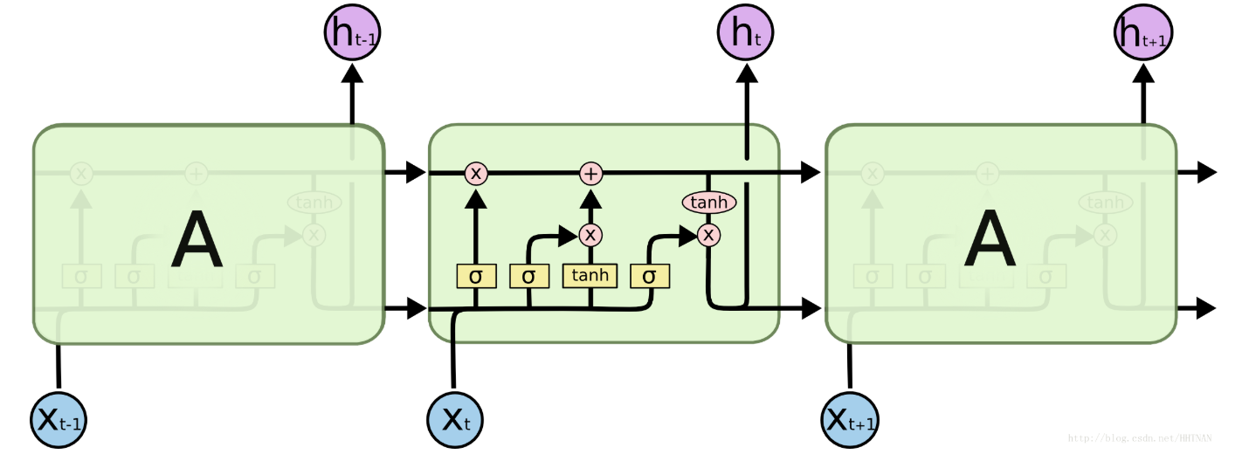
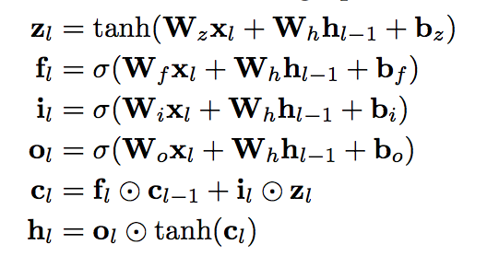
LSTM Layer
$$h_{l}$$
$c_{l−1}$-
$c_{l}$-
$$f_{l}$$
$$i_{l}$$
$$o_{l}$$
$$z_{l}$$
$$h_{l−1}$$
$$h_{l}$$
$$x_{l}$$

Slide 13
LSTM Layer
Adopt two fully-connected layers to get predictive score.
$τ$ = (u, interact, i)
$W_{1}, W_{2} :$ coefficient weights of the first and second layer

Slide 14
Weighted Pooling Layer
Aggregate scores of all paths.
The pooling function :
g($s_{1},s_{2},…,s_{k}$) = log[$\sum_{k=1}^{K}{exp⁡(\frac{s_{k}}{γ})}$]
Final prediction score :
${\hat{y}}_{ui}=σ$(g($s_{1},s_{2},…,s_{k}$))

Slide 15
Learning
The Objective Function
- Negative log likelihood
L = $−\sum_{(u, i εO^{+})}{log}$ ${\hat{y}}_{ui}+\sum_{(u, j εO^{−})}{log} {(1−\hat{y}}_{uj})$

Slide 16
Experiment

Slide 17
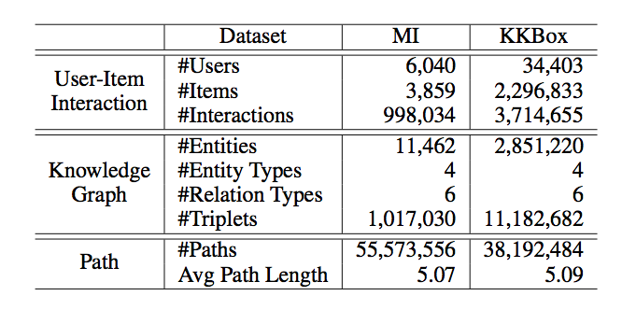
Dataset
Statistics of our datasets
(MI = MoiveLens-1M + IMDb)

Slide 18
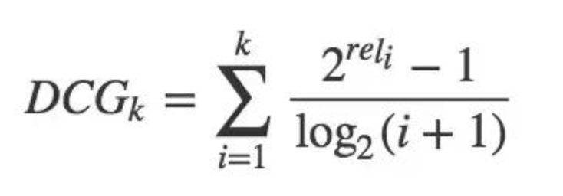
Evaluation metrics
hit@K
$$hit@K= \frac{NumberofHits@K}{\left|GT\right|}$$
ndcg@K

Slide 19
Comparison Baselines
MF
NFM (Neural Factorization Machine)
Embedding based methods
- CKE (MF + TransR)
Meta-path based method
- FMG (Meta-graph + MF)

Slide 20
Performance Comparison

Slide 21
Effects of Relation Modeling
The relation embedding is discarded to generate the input vector
6.45%
0.7%

Slide 22
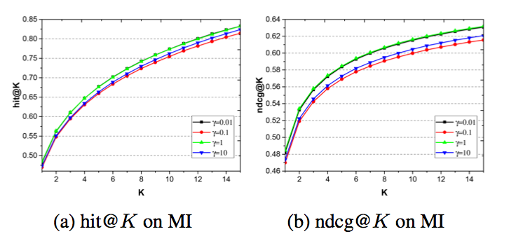
Effects of Weighted Pooling
g($s_{1},s_{2},…,s_{k}$) = log[$\sum_{k=1}^{K}{exp⁡(\frac{s_{k}}{γ})}$]

Slide 23
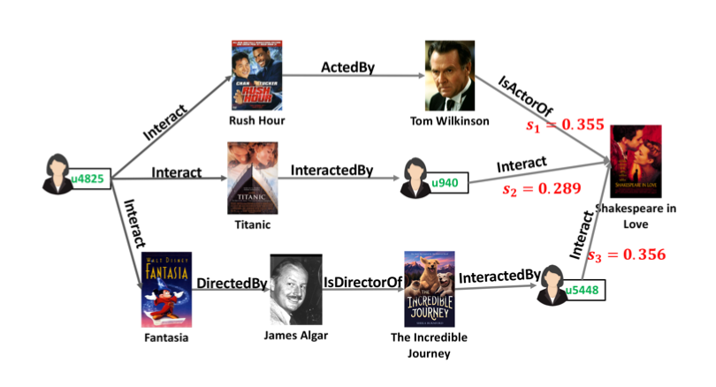
Reason on paths to infer user preferences towards items

Slide 24
Conclusion

Slide 25
Conclusion
We highlight the importance of performing explicit reasoning on KG to better reveal the reasons behind a recommendation.
We propose an end-to-end neural network model to learn path semantics and integrate them into recommendation.
We contribute a dataset to study KG for recommendation by aligning a MovieLens benchmark with IMDB.

